Slide 1
Career Exploration
Nick Maher

Slide 2


Career Options
Biology Degree- Iowa State University
Unmotivated And Uninterested
No Career Path

Slide 3

ACT Profiler
INTJ-
Mastermind
Introversion
Intuition
Judging
Thinking

Slide 4
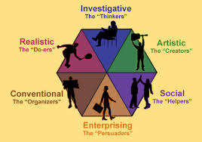
Holland Themes
Realistic- Computer Networks, Building
Investigative- Science, Solving Problems
Social- Helping, Teamwork

Slide 5


Informal Interview
Josh Van Heukelom, MBA
President/Chief Technology Officer- Orchestrate
Management Information Systems (MIS) Major

Slide 6

Informal Interview
Programing
Problem Solving, Self Sufficient
Startup Company

Slide 7
Career Objective
2 Year Web Development
Create Webpages And Apps To Fulfill The Needs Of My Company And Their Customers.
4 Year MIS Degree
Set Up Computer Systems To Help My Company Maximize The Benefit Of Personnel, Equipment, And Business Processes.

Slide 8

Qualifications
Associates Degree In Web Development
Build And Maintain Websites And apps
HTML/XHTML, CSS, JavaScript
Server/Client Architecture
Utilize Databases
Validation

